Slide 1
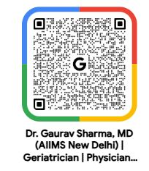
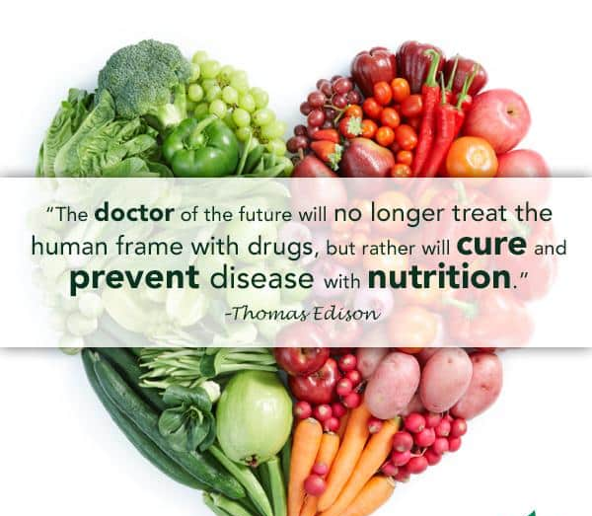
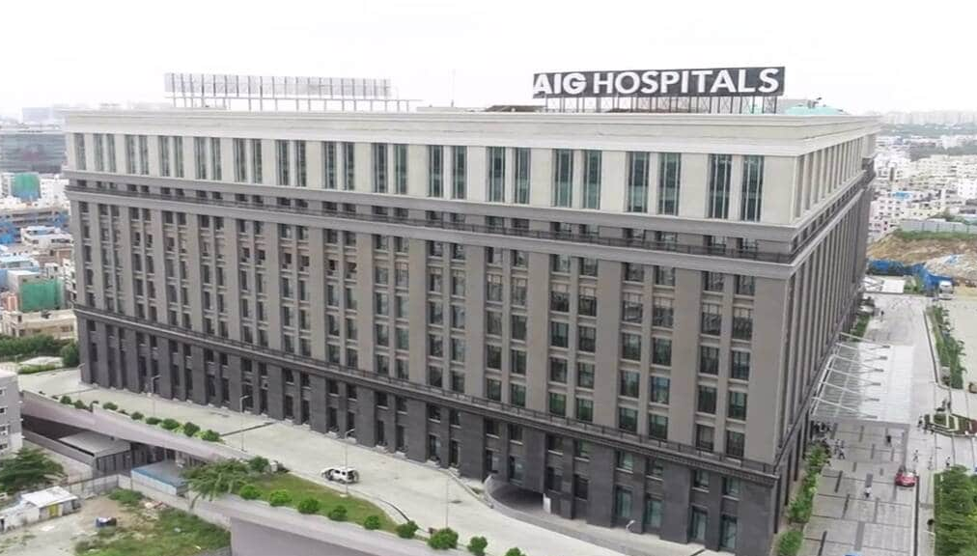
Geriatric Nutrition : Myths and Realities
Dr Gaurav Sharma MD AIIMS New Delhi
Ex- Senior Resident IMS BHU
Currently Consultant Geriatric Medicine AIG Hospitals, Hyderabad

Slide 2
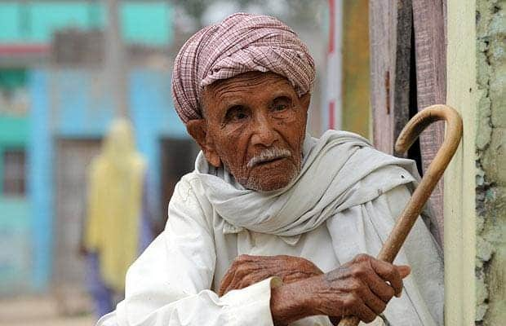
Not eating enough due to chewing and teeth problems
Its difficult to walk, thus its hard to shop for food
Diet restriction due to my high BP, Heart disease,diabetes makes eating less interesting
I often feel sad and loose my apetite

Slide 3
Outline of Presentation
Nutritional challenges in older persons
Assessment of nutrition
Nutritional requirements
Take home message

Slide 4
Introduction
Aging is an irreversible, biological change that occurs throughout an individual’s life.
Changes associated with aging
Physiological Changes
Socio-Psychological Changes
Biological Changes
Changes
leads to
Dietary Deficiencies
Impaired Digestion and Absorption
Accumulation of Waste Products
Dietary Intake
Inefficient Utilization of Nutrients
Alter Nutrient Need

Slide 5
Role of Diet in Aging
Major Determinant for Active Aging
Increase Longevity
Prevent Chronic Diseases
Provides Immunity
Provides Good Health
Notes:
Nutrition is a

Slide 6
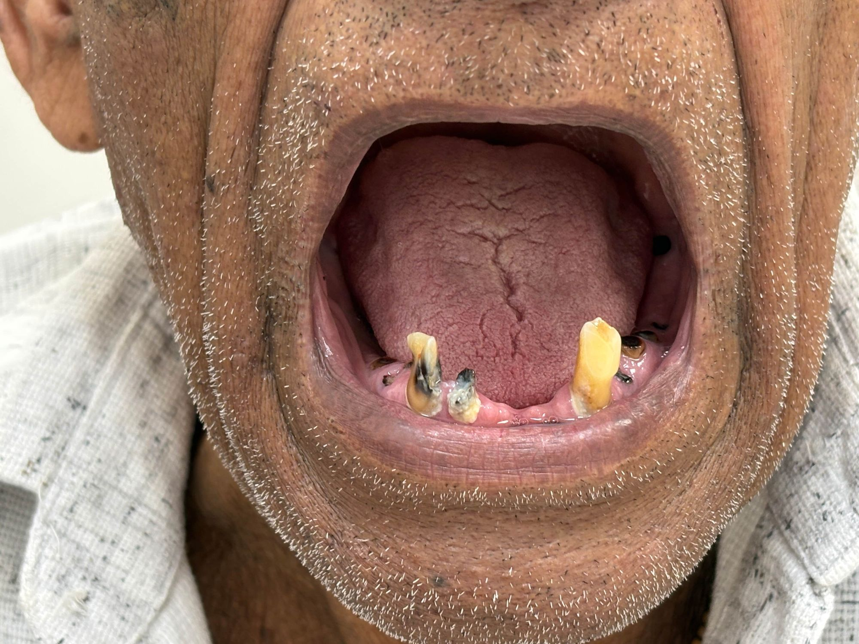
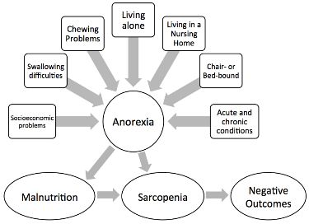
RISK FACTORS
*Anorexia of Aging: Risk Factors, Consequences, and Potential Treatments
Francesco Landi *, Riccardo Calvani, Matteo Tosato, Anna Maria Martone, Elena Ortolani, Giulia Savera, Alex Sisto and Emanuele Marzetti

Slide 7
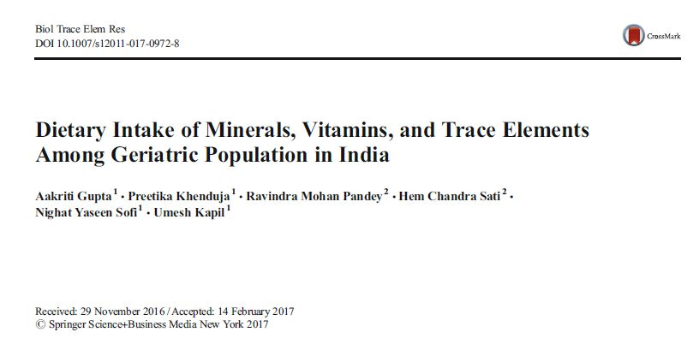
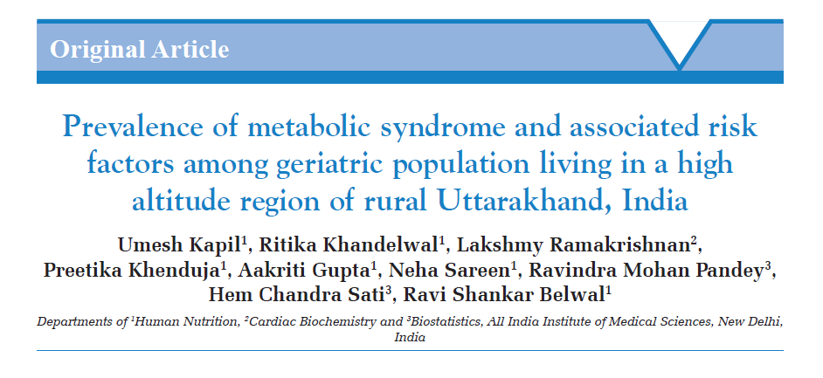

Slide 8
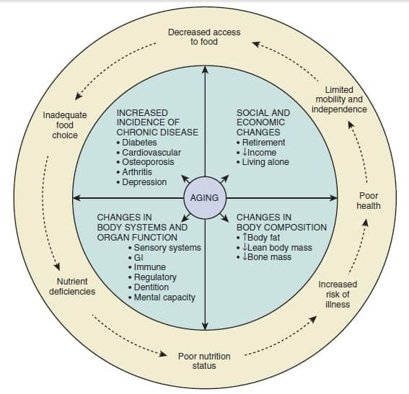
FACTORS AFFECTING NUTRITION
*Brocklehurst’s Textbook of
Geriatric Medicine and
Gerontology 8th Edition
*Factors associated with poor nutritional status among the oldest-old Luxi Ji a,
Hongdao Meng b, Birong Dong

Slide 9
Nutrition Related Problems Among Geriatrics
Obesity
Undernutrition
Diabetes
Hypertension
Cardiovascular diseases
Liver disease
Renal disease
Gout/ arthritis
Osteoporosis
Cancer

Slide 10
Common Myths
Older people should eat very little
Protein is harmful for kidneys
Milk and curd cause cough or cold
Fruits are not good for diabetes
Fat should be completely avoided
Weight loss is normal in old age

Slide 11
PROTEIN INTAKE
1-1.25 g/kg/day in order to maintain protein equilibrium and avoid loss of lean body mass
1.5 g/kg/day in older acutely ill (except in chronic Renal or Liver Disease)
Need may reach upto 2 g/kg/day in severly ill or sepsis
*Bauer J, Biolo G, Cederholm T, et al: Evidence-based recommendations for optimal dietary protein intake in older people: a position paper from the PROT-AGE Study Group.
*Tieland M, Borgonjen-Van den Berg KJ, van Loon LJC, et al: Dietary protein intake in community-dwelling, frail, and institutionalized elderly people: scope for improvement.
*Protein Requirements and Recommendations for Older People: A Review. Nowson C, O'Connell S
10-35 % of total energy requirements

Slide 12
CARBOHYDRATE INTAKE
55% to 70% total energy requirements
Based on 2 considerations
Sources of Carbohydrate Energy Requirements
In form of complex carbohydrate (whole grains, vegetables, and fruits)
Energy, protein, and fat requirements of the individual are determined first f/b carbohydrate by substraction.

Slide 13
FAT INTAKE
20-30% of total energy requirements
Shouldn’t fall below 10% even if there is risk of obesity or elevated TG and Cholesterol
*Dietary Reference Intakes for Energy, Carbohydrate, Fiber, Fat, Fatty Acids, Cholesterol, Protein, and Amino Acids. Institute of Medicine and National Academies Press 2005 *Hazzard’s Geriatric Medicine and Gerontology 7th edition
Omega-6 fatty acids -1% of total energy requirements
(vegetable oils, nuts, cereals, seeds, and legumes etc)
Omega-3 fatty acids – 0.2 % of total energy requirements
(seafood, soybeans, spinach, fish oil, cold water fish and walnuts etc)
*Dietary Reference Intakes for Energy, Carbohydrate, Fiber, Fat, Fatty Acids, Cholesterol, Protein, and Amino Acids. Institute of Medicine and National Academies Press 2005
*Eating and aging: Trends in dietary intake among older Americans from 1977–2010
Mediterranean-style diet
Promotes the use of olive oil, tree nuts and peanuts, fatty fish, seafood, and white meat, and
Discourages intake of red and processed meats

Slide 14
FIBRE INTAKE
20-35 g/day or 10-13 gm/1000kcal
*Institute of Medicine, Food and Nutrition Board: Dietary reference intakes for energy, carbohydrates, fiber, fat, protein, and amino acids (macronutrients), Washington, DC, 2002, National Academies Press
*NUTRITION IN THE ELDERLY: ROLE OF FIBER Archives of Gerontology and Geriatrics
2 types
Water insoluble
(Cellulose, Hemicellulose,Lignin)
Reduces Constipation
Water soluble
(Gums and Pectins)
Reduces postprandial
surge in the serum glucose
Lower total and LDL Cholesterol by 3-10%

Slide 15
WHOM TO SCREEN?
Older individuals
Who have experienced a recent deterioration in their socioeconomic status
With recent deterioration in physical or cognitive function
Who had Change in the number or type of medications prescribed
Who are hospitalized due to an acute illness
Who are living alone
*HAZZARD’S GERIATRIC MEDICINE AND GERONTOLOGY 8TH EDITION
*A.S.P.E.N. Clinical Guidelines Nutrition Screening, Assessment, and Intervention in Adults
*Assessment and management of nutrition in older people and its importance to health. Ahmed T, Haboudi N

Slide 16
Assessment of nutrition
Nutritional screening
Comprehensive nutritional assessment
Anthropometric measurements
Biochemical/ Lab methods
Clinical methods
Dietary assessment
Evaluation of psychosocial factors

Slide 17
NUTRITIONAL SCREENING TOOLS
Nutritional Risk Screening (NRS)
Simplified Nutrition Assessment Questionnaire (SNAQ),
SCREEN II (Seniors in the Community: Risk Evaluation for Eating and Nutrition)
The Malnutrition Universal Screening Tool (MUST)
Malnutrition Screening Tool (MST)
Mini Nutritional Assessment (MNA)
Mini Nutritional Assessment-Short Form (MNA-SF)

Slide 18
1. ANTHROPOMETRY
Skinfold Thickness
Arm and Arm Muscle Circumferenece
Waist Circumference
Waist to hip ratio
BMI
Subcutaneous fat stores
Muscle mass and subcutaneous fat
Poor reliability
prognostically important assessment
Abdominal fatness
*Hazzard’s Geriatric Medicine and Gerontology 7th edition
*Beck AM, Ovesen L: At which body mass index and degree of weight loss should hospitalized elderly patients be considered at nutritional risk? Clin Nutr
Tissue mass
(Muscle, fat, bone)

Slide 19
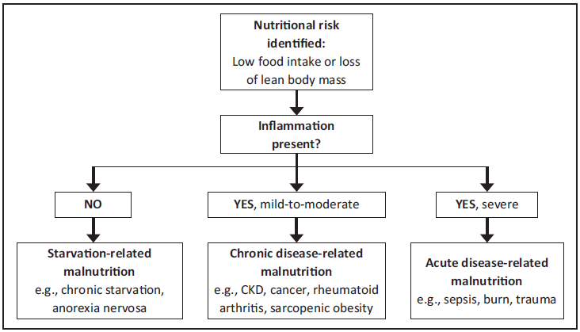
anorexia of ageing

Slide 20
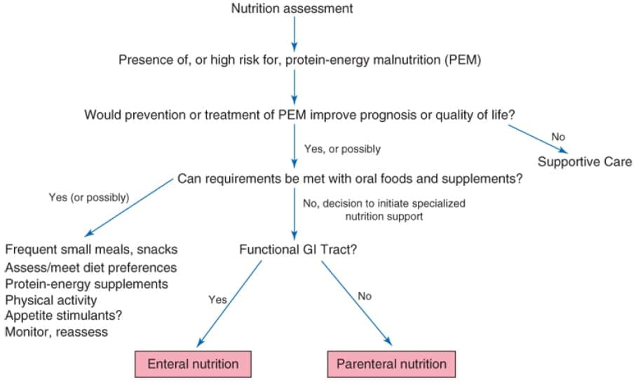
MANAGEMENT OF MALNUTRITION
*Halter JB, Ouslander JG, Tinetti ME, Studenski S, High KP, Asthana S, editors. Hazzard's Geriatric Medicine and Gerontology 7th edition

Slide 21
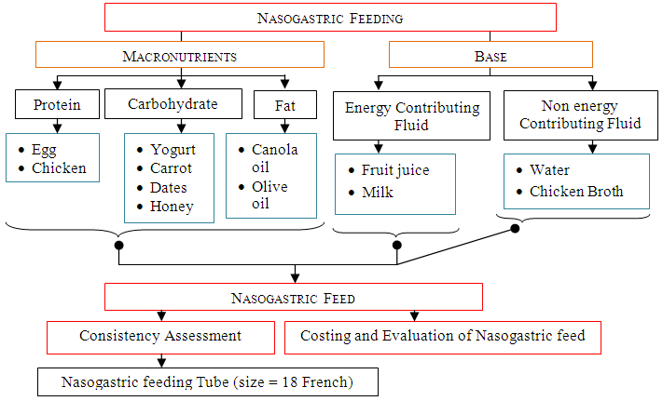
Preparation of home made enteral feed

Slide 22

Weight Reduction Diet/ Obese Diet
Medical Nutrition Therapy
To bring about a gradual weight loss
To maintain desirable weight
To provide good nutritional status by adequately balanced diet
To correct faulty food habits
Cereals-Oats
Pulses- dehusked
Fruits and Vegetables
Milk- low fat (double toned)
Meat and Poultry
Oils- mustard, soyeabean
Fried and Sweetened foods
High carbohydrates- Potato, colocasia
Carbonated, packed beverages- fruit juices
Alcoholic drinks

Slide 23
Diabetic Diet
Medical Nutrition Therapy
To determine energy requirement
To distribute the energy in Kcal, Pro, Carbs and fibre
To provide nutrient rich diet
Recommendation Pattern: 3 major meals + 3 minor meals
Whole cereals and pulses- Oats
Fruits and Vegetables- Papaya
Milk and its products- Low fat
Egg white, fish, chicken
Oil- Mustard, rice bran
Refined cereal- Maida
High fat foods- butter, cheese, mayonnaise
Fried and empty calorie foods
Carbonated, packed beverages- fruit juices
Alcoholic drinks

Slide 24
SRD Diet
Salt Restricted Diet
Customized on severity of the patient’s condition.
Medical Nutrition Therapy
To reduce the sodium intake
To maintain adequately nourished diet
Cereals- Rice, Oats
Pulses
Fibre rich Fruits and Vegetables
Milk and milk products
Egg white, chicken
Oil- Mustard, safflower
Salt on Top
Dried nuts
Sea salted foods
Processed foods- butter, cheese
Fried and sweetened foods
Alcoholic beverages

Slide 25
Vitamins and trace mineral requirements (RDA)
Micronutrient | Parenteral Dose
Vitamins:
Vitamin A | 3300 IU
Vitamin D | 200 IU
Vitamin E | 10 IU
Vitamin K | 150 μg
Ascorbic acid (Vit. C) | 200 μg
Folic acid | 600 μg
Niacin | 40 mg
Riboflavin (Vit. B2 ) | 3.6 mg
Thiamine (Vit. B1 ) | 6 mg
Pyridoxine (Vit. B6) | 6mg
Micronutrient |  | Parenteral Dose
Cyanocobalamin (Vit.B12) |  | 5 μg
Pantothenic acid |  | 15 mg
Biotin |  | 60 μg
Trace Elements
Zinc | 2.5–5 mg
Copper | 0.3–0.5 mg
Chromium | 10–15 μg
Manganese | 60–100 μg
Selenium | 20–60 μg

Slide 26
Take Home Message
Each diet is customized individually based on
Medical Condition
Feeding Pattern
Socio-Economic
Cultural Factors
Protein is your friend
Weight loss is not normal
Hydration saves lives
Ageing ≠ starvation
Traditional Indian food can be healthy

Slide 27
